Slide 1





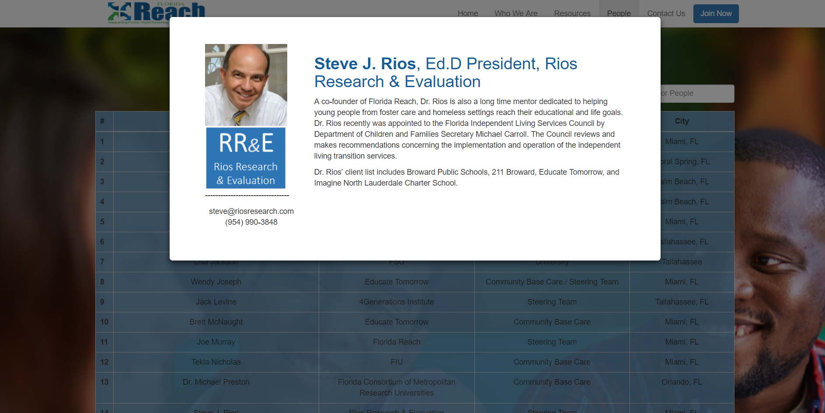
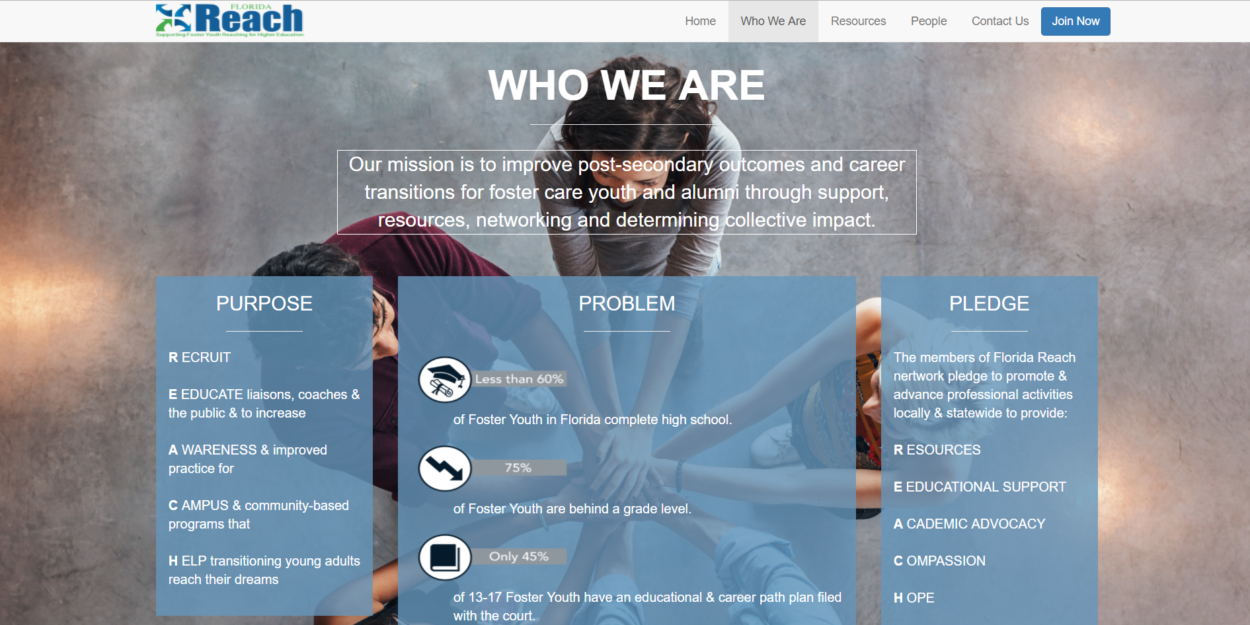
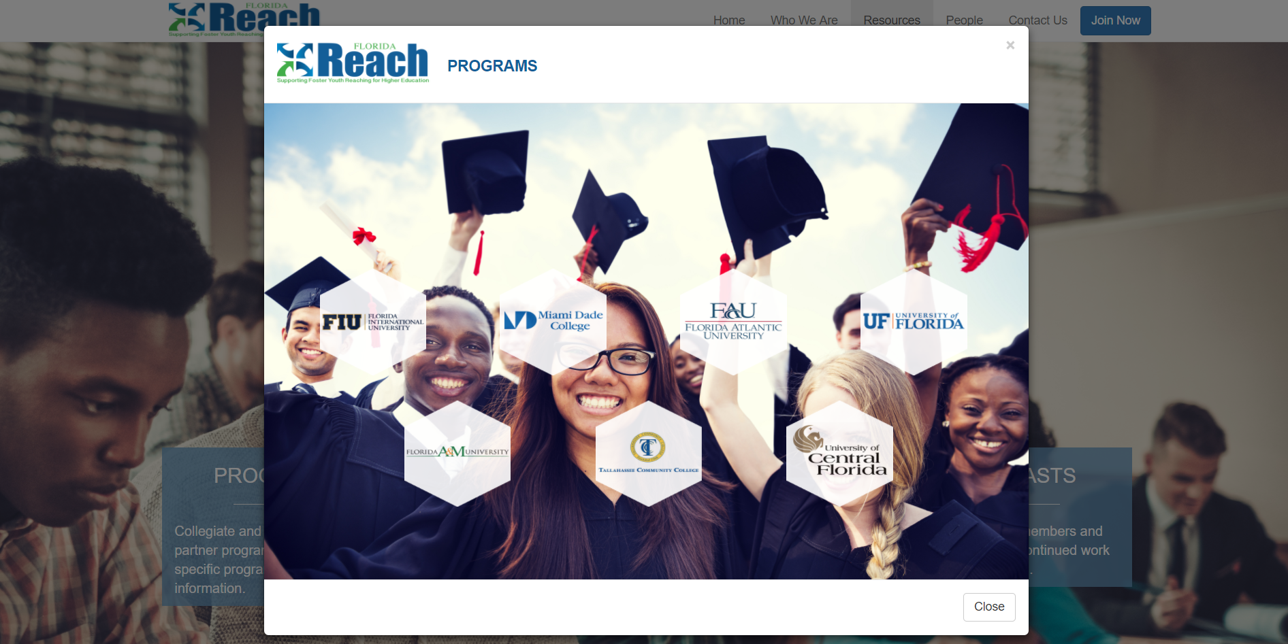


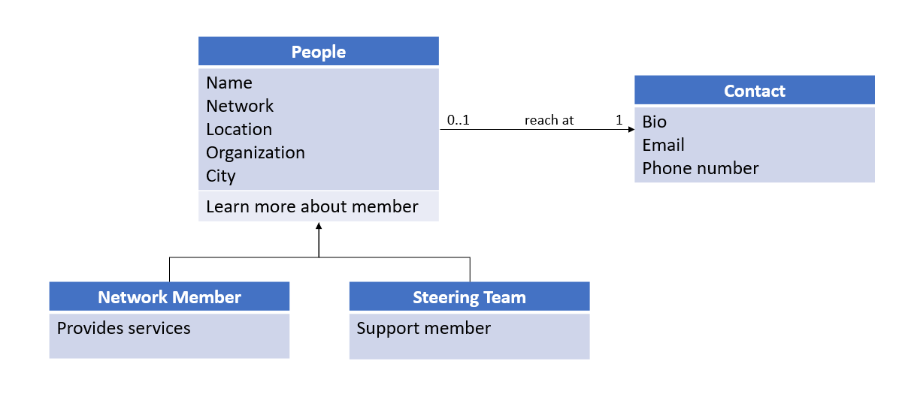
School of Computing & Information Sciences
Senior Project, 2017, Summer
Apps, Arts and Issues:
APPlying the Arts to Digital Communication
Student: Ranses Melo, Florida International University
Mentor: Francisco Ortega, Margo Berman, Florida International University
Instructor: Masoud Sadjadi, Florida International University
Problem
Reaching Positive Pathway members and information in a centralized environment.
How do we help youth from foster care reach their educational goals?
Solution
Develop a website that incorporate the tools to connect members throughout Florida.
Dedicated program page to inform foster care youth of post-secondary education programs and services available in the State.
Current System
Information accessed through a 3rd party website.
Information is all over the place and is not clear the objective of the organization.
Screenshots
Requirements
Develop a visually appealing interactive, user friendly website
The positive pathway website seeks to grow a network of post-secondary educational support and services by enhancing communication and training
Allow Network members and individuals interested in supporting the ability to serve and support in various forms and methods.
System Design
Implementation
Programming Languages: HTML, CSS, Javascript, Typescript
Frameworks and Technologies: Angular CLI, NodeJS, Bootstrap, jQuery
Verification
Tested all user stories to ensure they worked together.
Tested that every component in the web application works and do their functionality.
Object Design
Summary
The first version of this website is a single page application.
It has potential to add more useful futures.
It offers a future possibility to implement a phone app.
Acknowledgement
The material presented in this poster is based upon the work supported by Dr. Steve Rios and Prof. Margo Berman. I am thankful to the help that I received from my group members: Claudia Gourdet, Jose Ayala, Derek Hernandez, Enrique Hidalgo, Mariel Juarez, Nathalie Llaneza
Notes:
1

